Slide 1
Team project presentation A17_6
Team Leader | Mohammed Mahin Ibnay Mamun
Product Owner | Shoyombo Oreoluwa
Quality Controller | Keros Banda
Team Member | Naysharn Arrowsmith
Team Member | Qamar Iqbal Gutierrez
Team Member | Jensen Norris
Team Member | Divine Uchegbulam
Notes:
Created by mohammed mahin ibnay mamun

Slide 2
Group individual engagement
ALL
Mohammed Mahin Ibnay Mamun
Plan team meetings
Assign tasks on Trello
Approve documentations including wireframe and sprint.
Keros Banda
Logo design
Bug fixes
Shoyombo Oreoluwa
complete sprint document
Helped the team out with some researches
Naysharn Arrowsmith
created fitness page and research into how fitness can boost mental
research into relevant websites
Qamar Iqbal Gutierrez
Logo design
Designs and setup of mental health page
Reasearch
Divine Uchegbulam
Created website pages
Fixed errors
Jensen Norris
Gathered Research
Helped create web pages
Notes:
Created by mohammed mahin ibnay mamun

Slide 3
Problem Domain
Naysharn
Problem Identification:
Recognizing mental health issues and their impacts.
Defined Requirements:
Develop a website dedicated to mental health awareness.
Gather information on existing platforms for inspiration and understanding.
Project Aims:
Create a platform to highlight mental health conditions and their effects.
Increase awareness about mental health issues.
Provide guidance and advice, potentially incorporating fitness solutions.

Slide 4
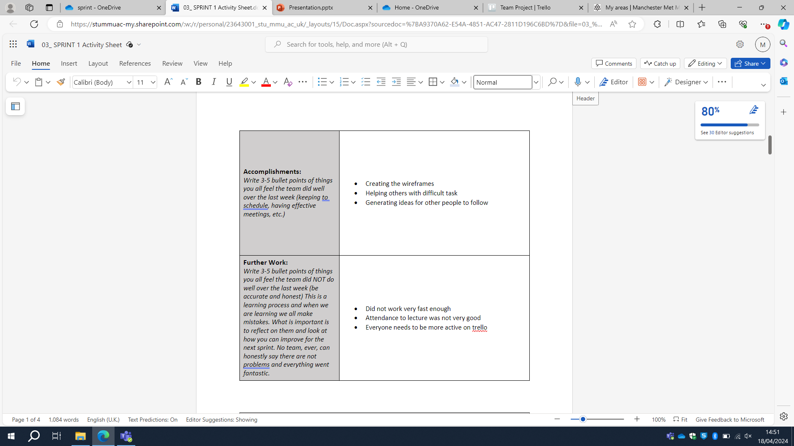
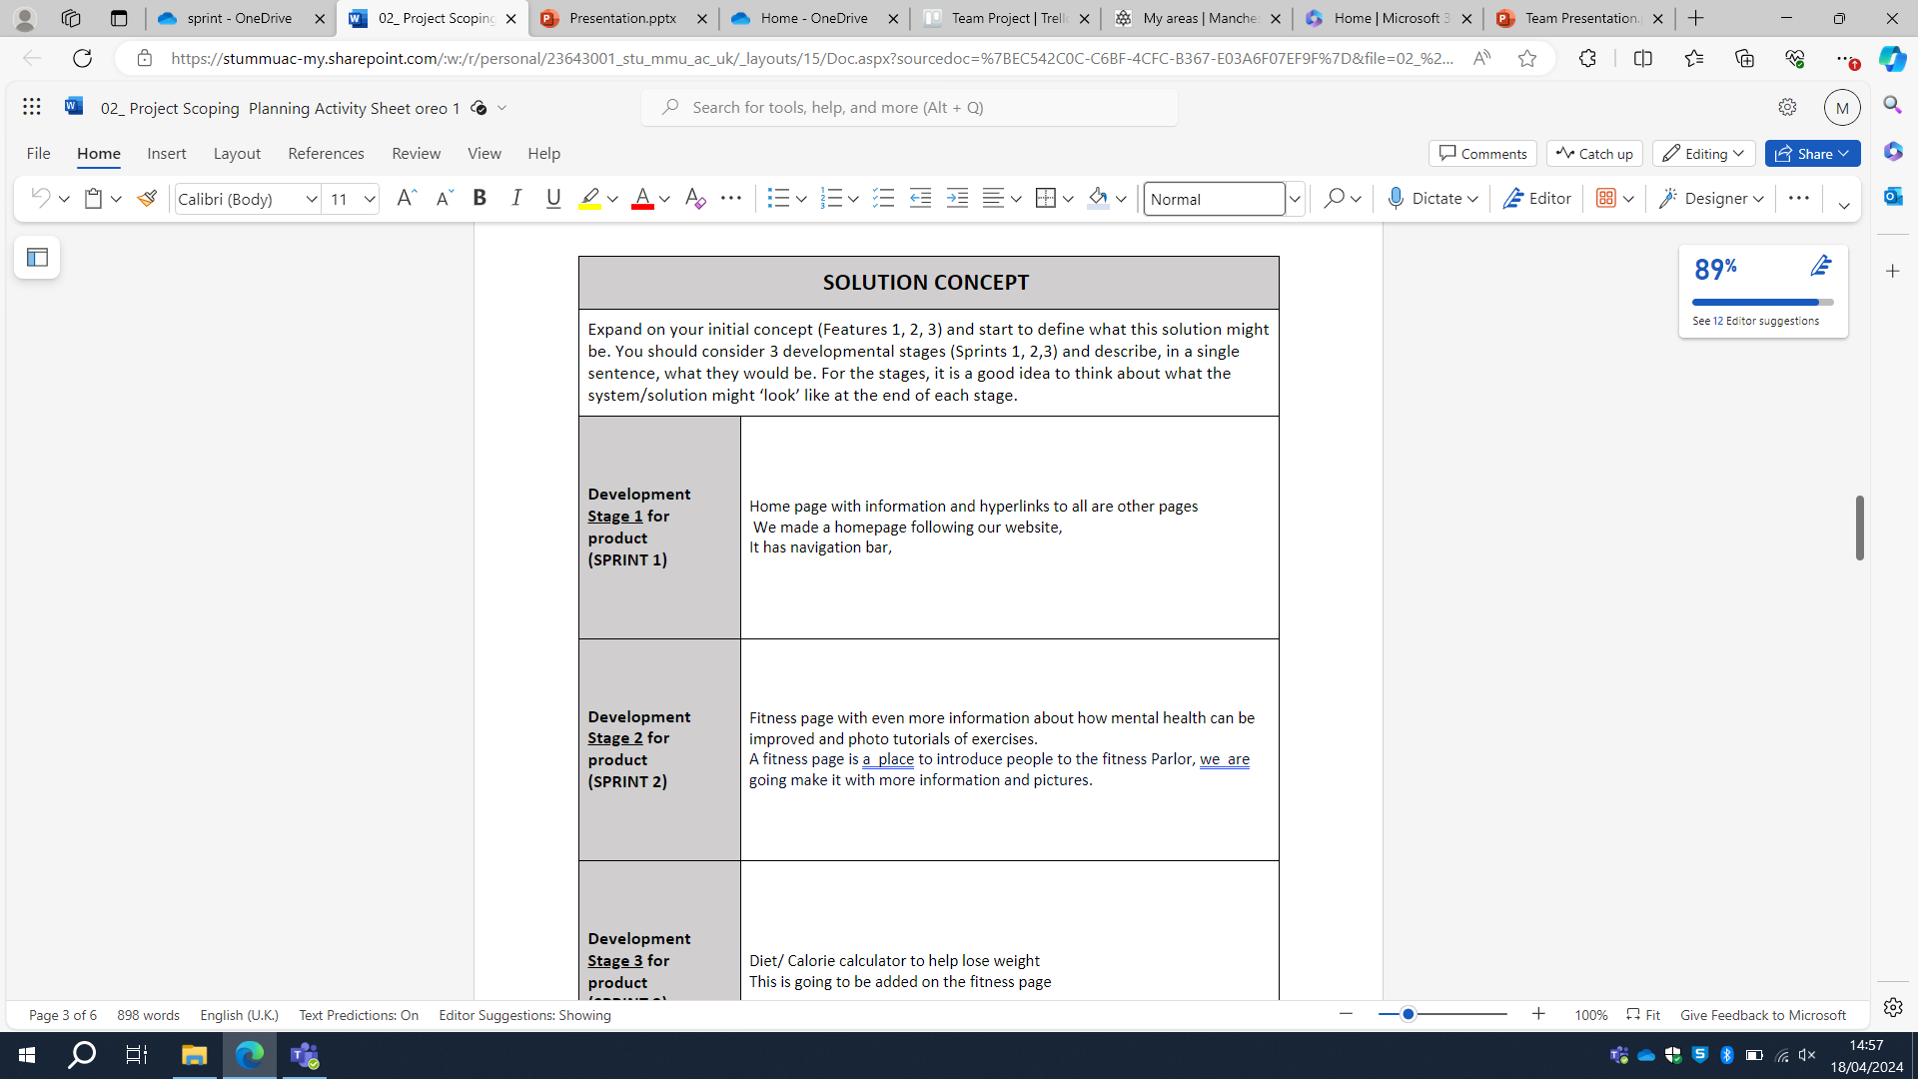
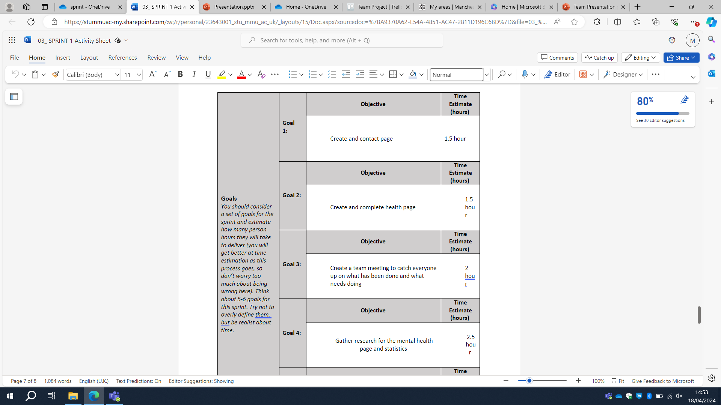
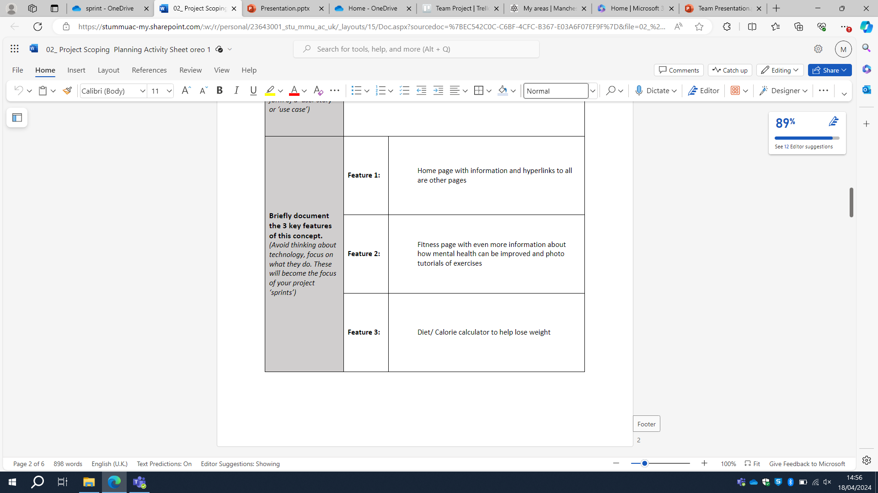
Sprint sheets and Word documents
All

Slide 5
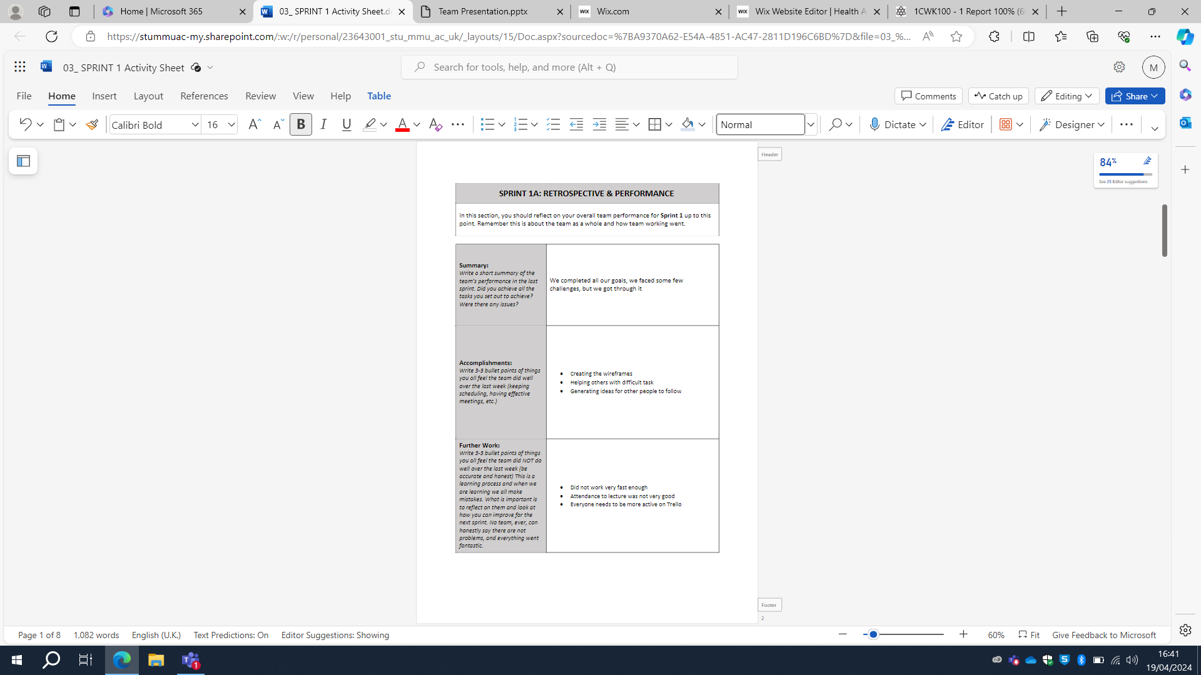
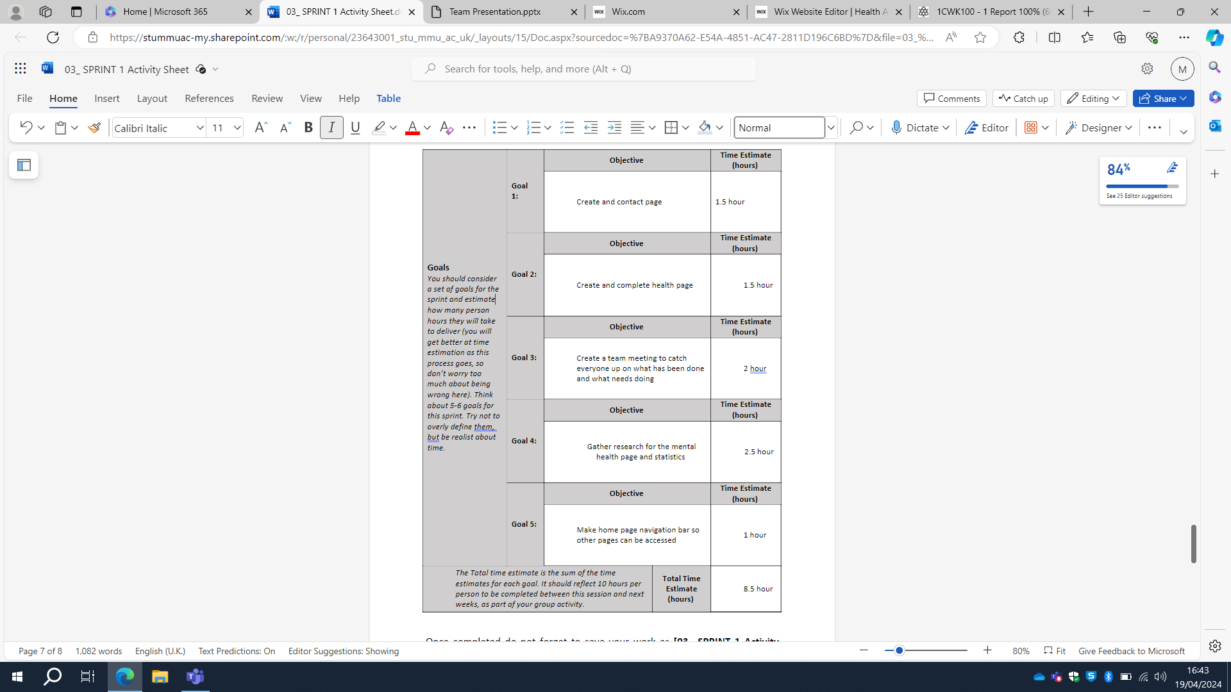
First sprint
Oreoluwa
What was the problem being addressed?
How was it tested and assessed?

Slide 6
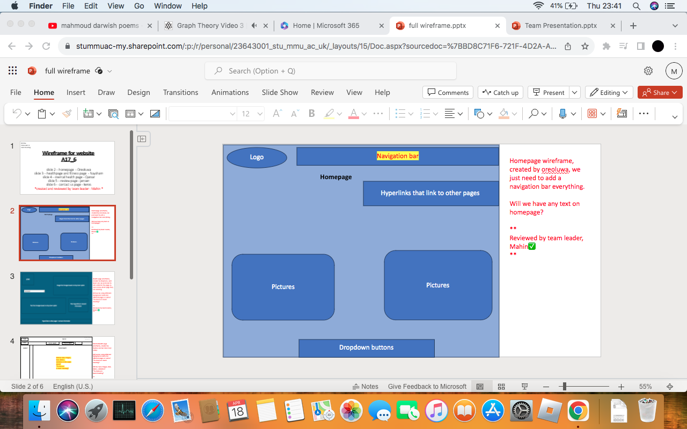
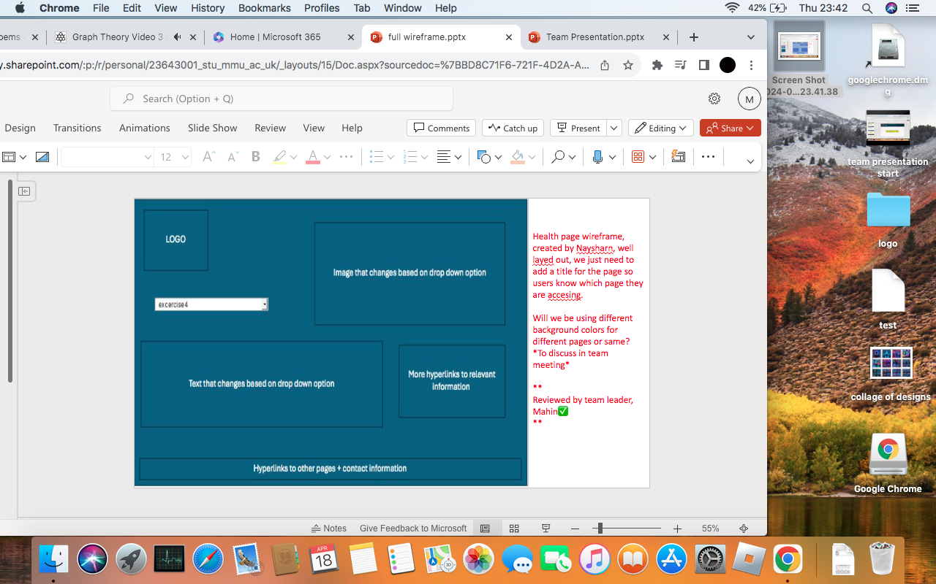
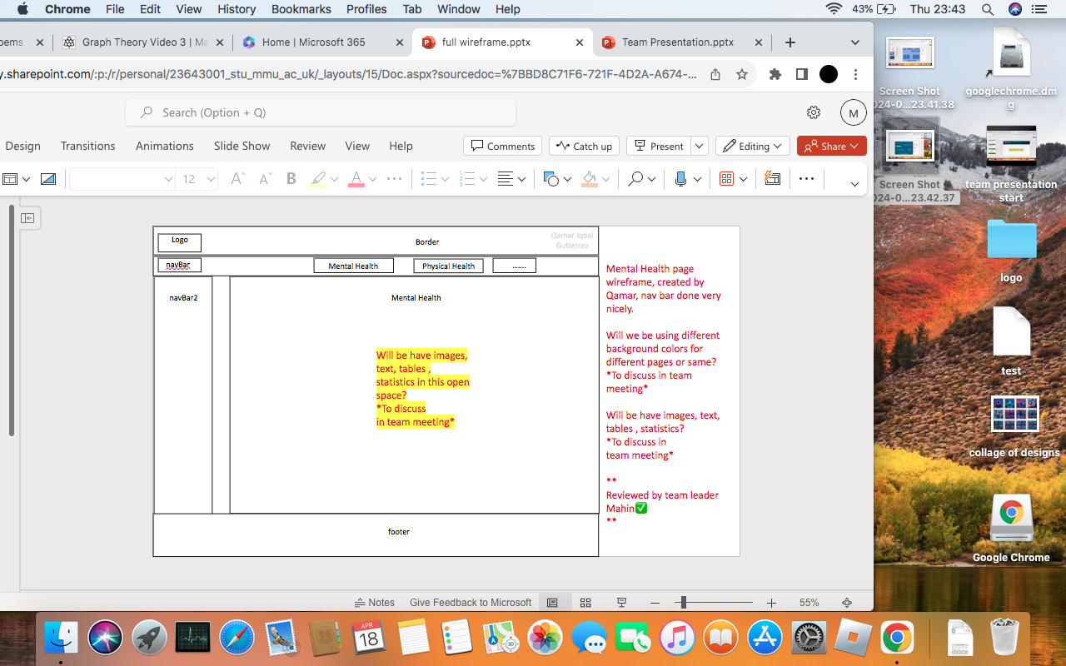
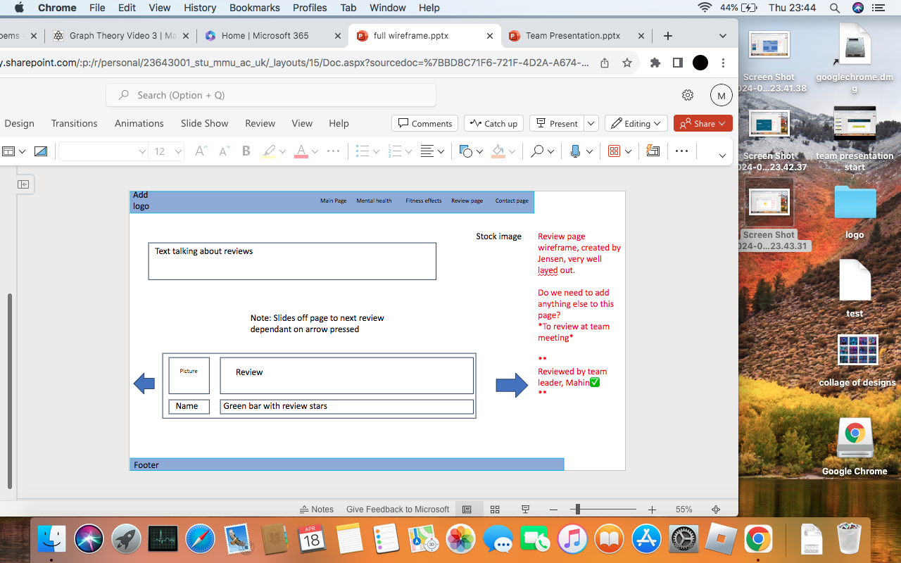
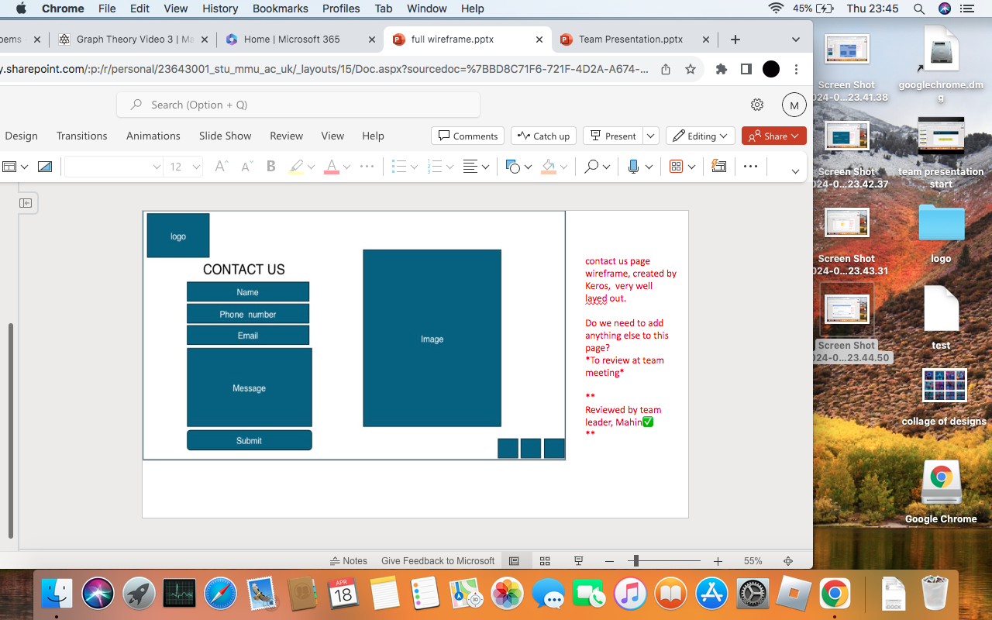
Wireframe design
Mahin

Slide 7
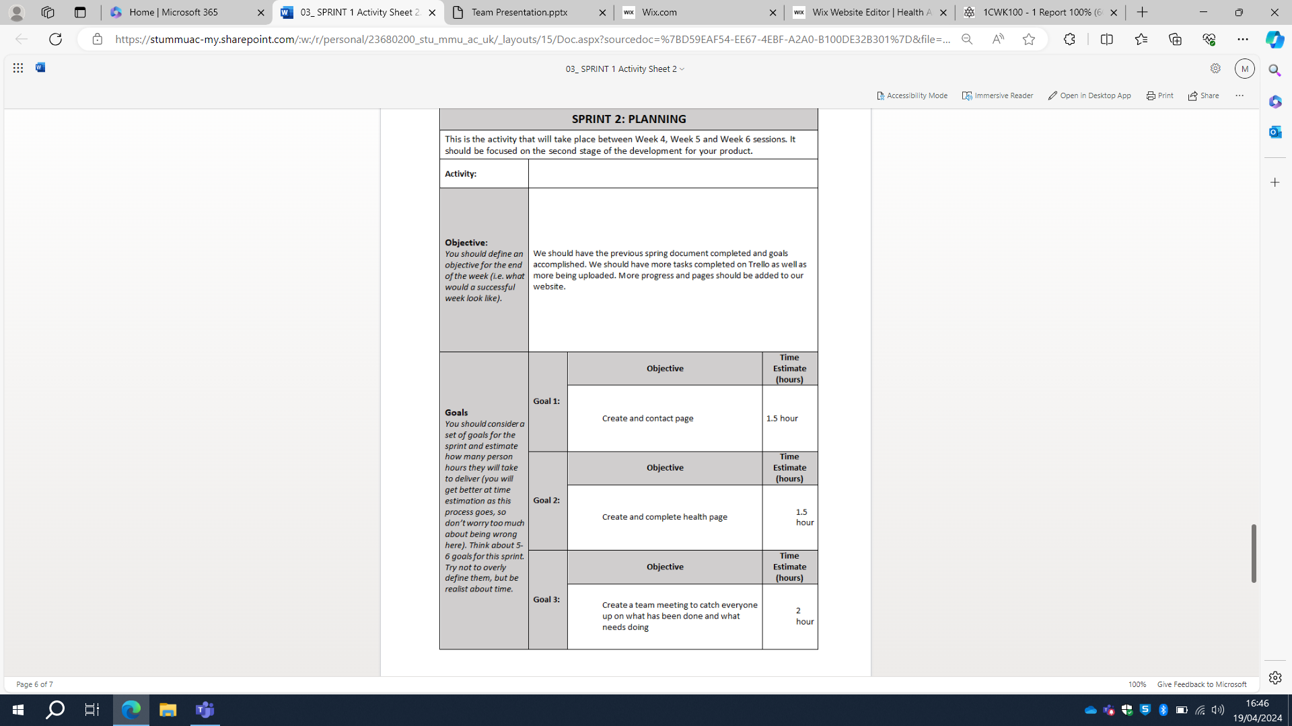
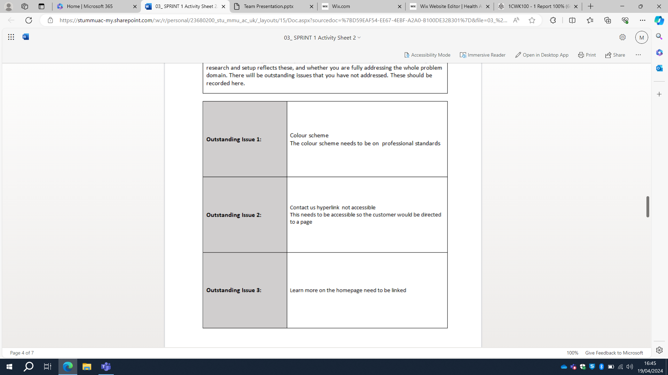
Second sprint
Keros
What was the problem being addressed?
How was it tested and assessed?

Slide 8
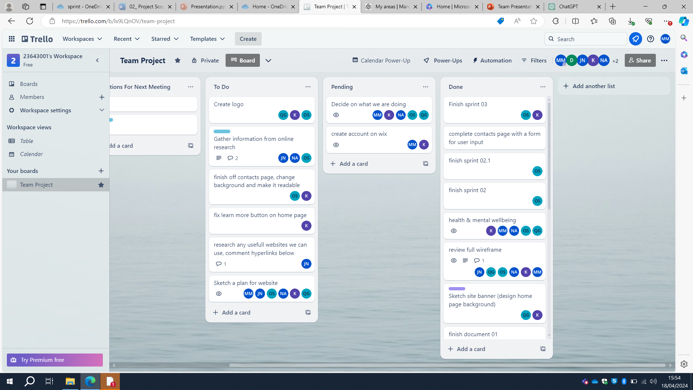
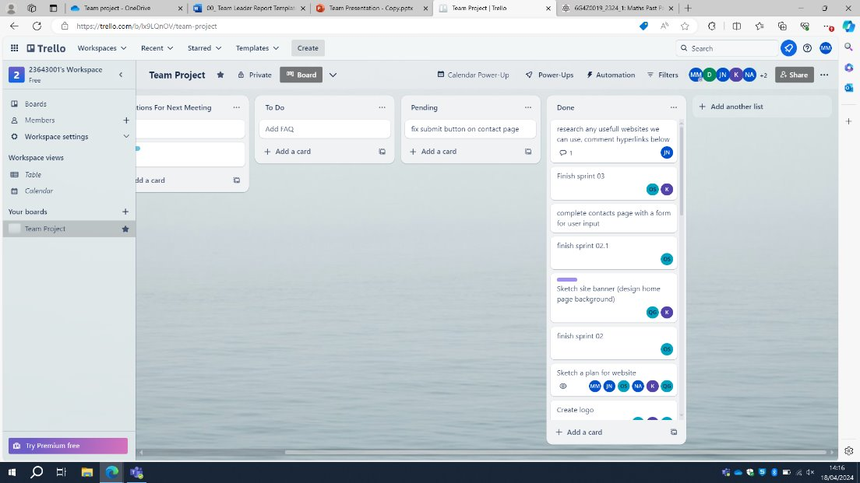
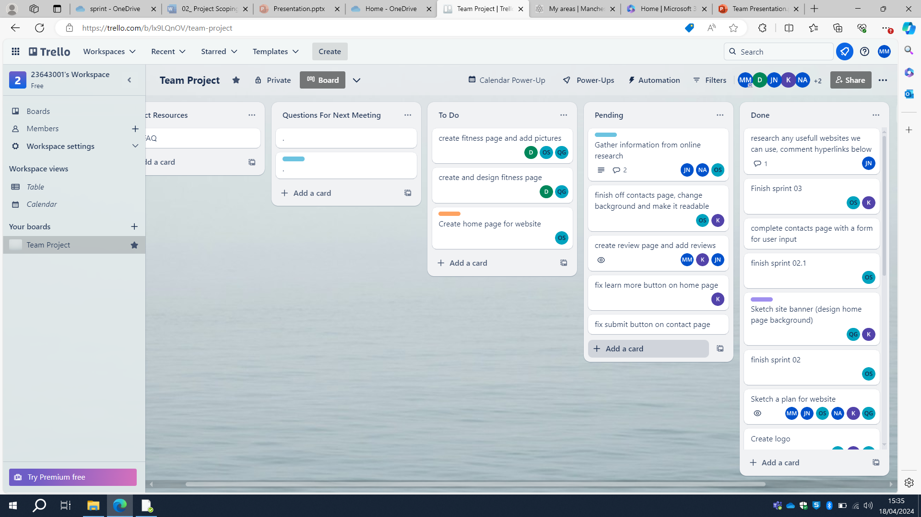
Trello Board
Mahin

Slide 9
Team approach to developing the problem
Mahin
Utilized Trello site from the first team meeting for task partitioning.
Drafted website layouts on paper before creating a rough PowerPoint wireframe.
Developed a website based on the wireframe.
Initial responsibility for each member was their own page creation.
Researching further into the topic to find trusted sources.
Created a logo to stand out from other websites.
Refer to Trello for tasks.

Slide 10
Website development
Qamar
Problems during development:
-During working hours could not edit website at the same time as others.
-Members joining late caused work to be shifted around.
-Attendance to group meetings is low.

Slide 11
Website build and evaluation
Qamar
Personal responsibilities included:
-Completing tasks on time
-Tasks done correctly
-Don’t bring anyone down
Team responsibilities include:
-Recap and document after each sprint
-Attending meetings
-Motivating everyone
-Team progress

Slide 12
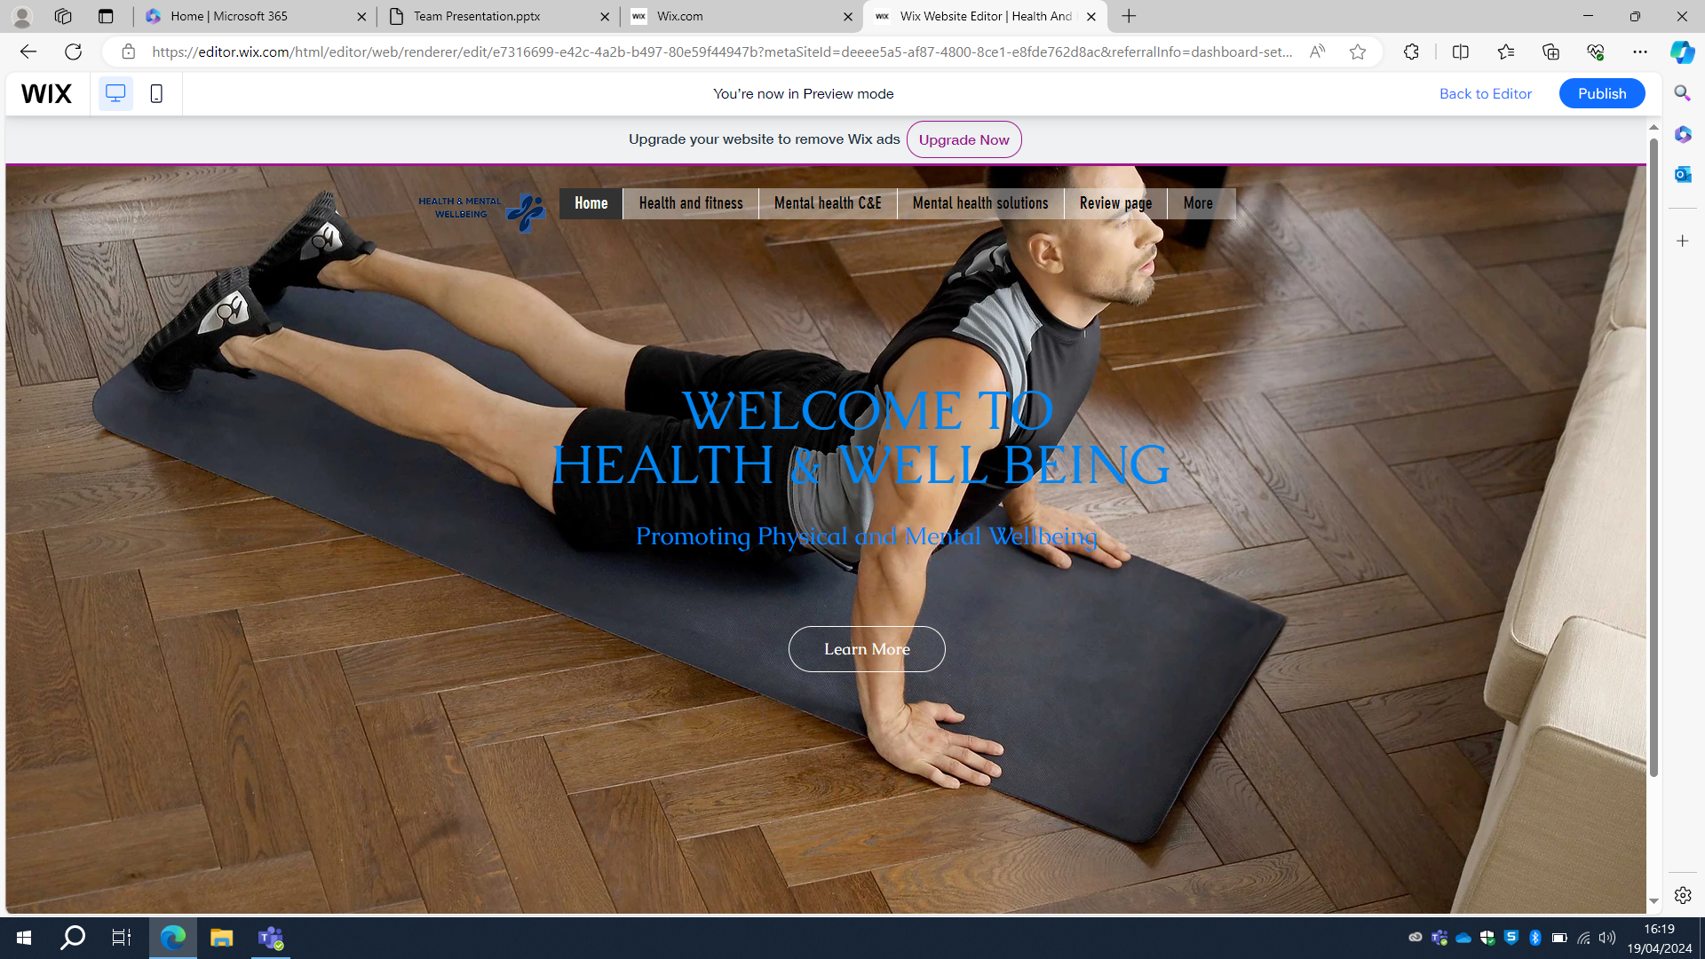
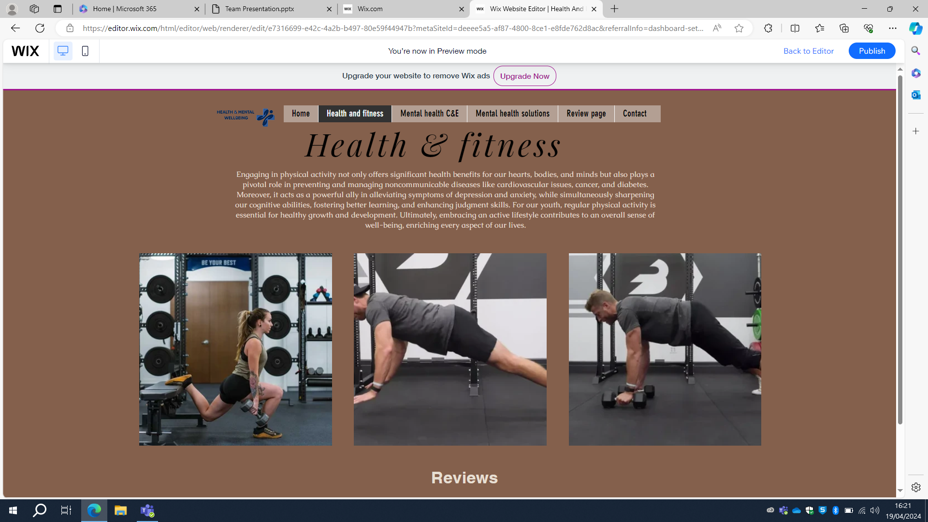
Final design
Keros

Slide 13
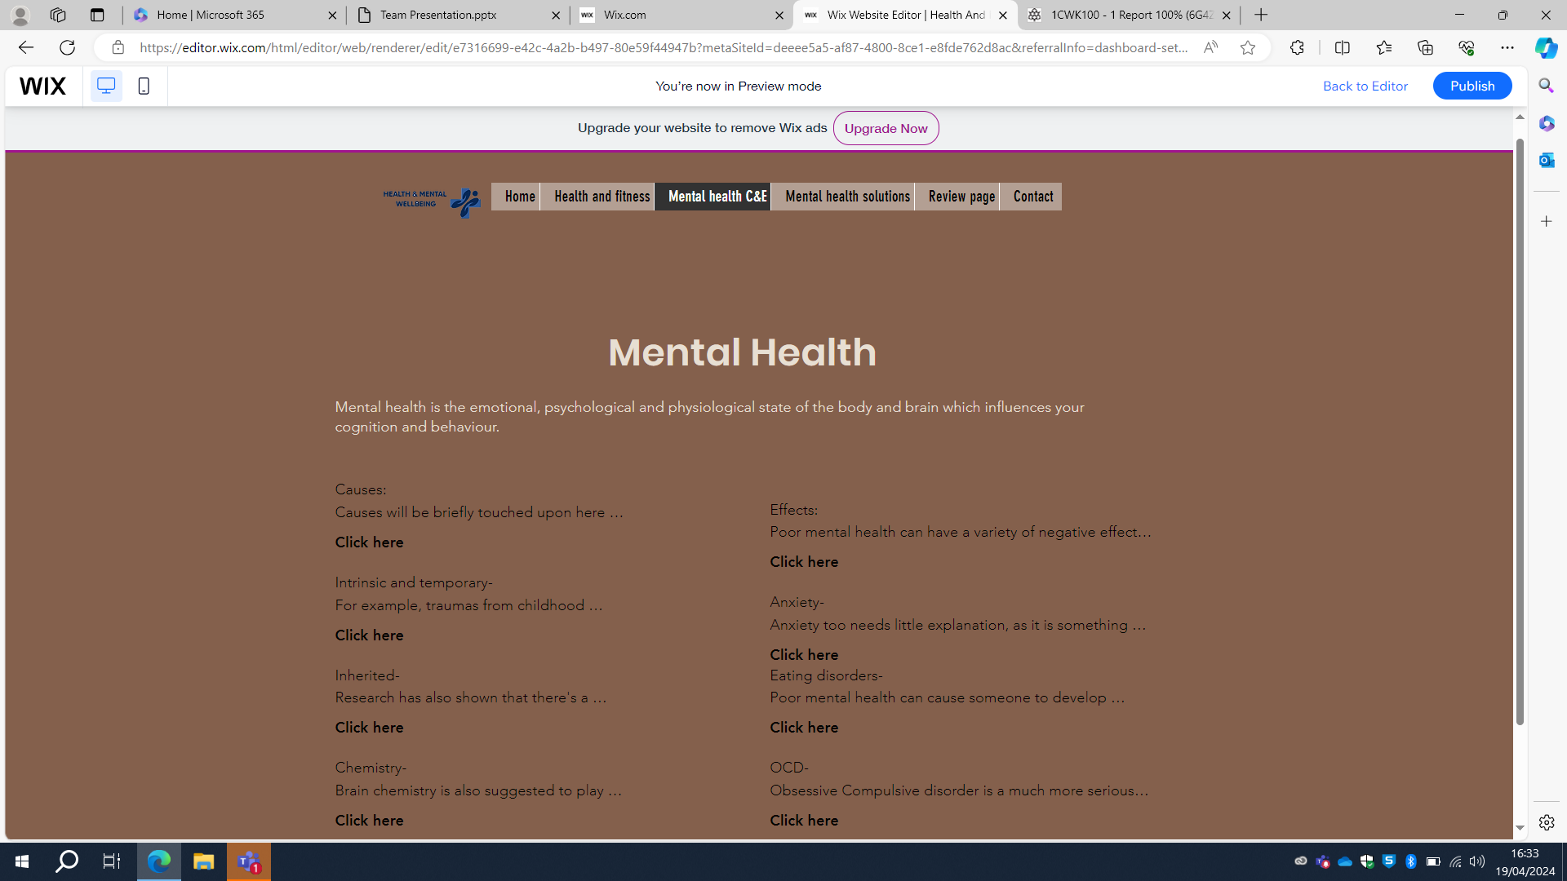
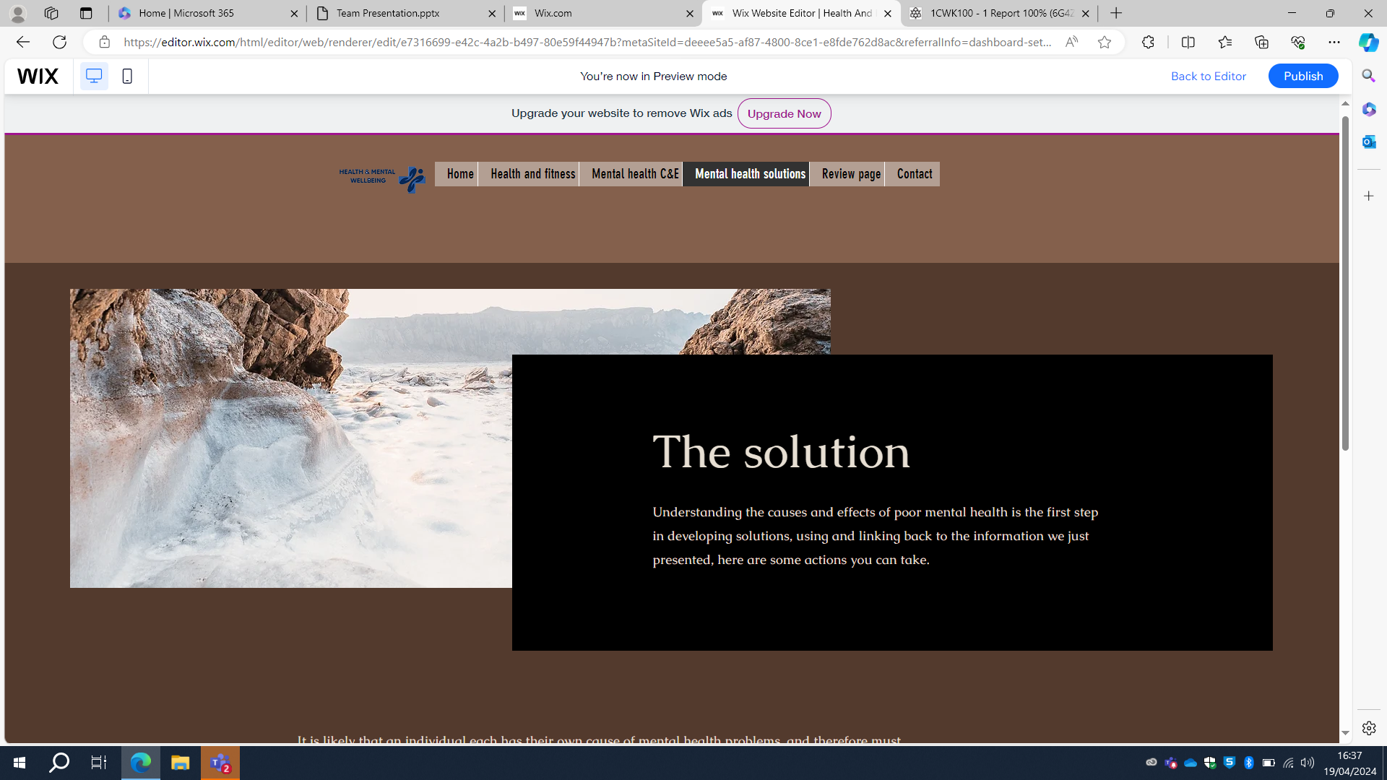
Final design
Keros

Slide 14
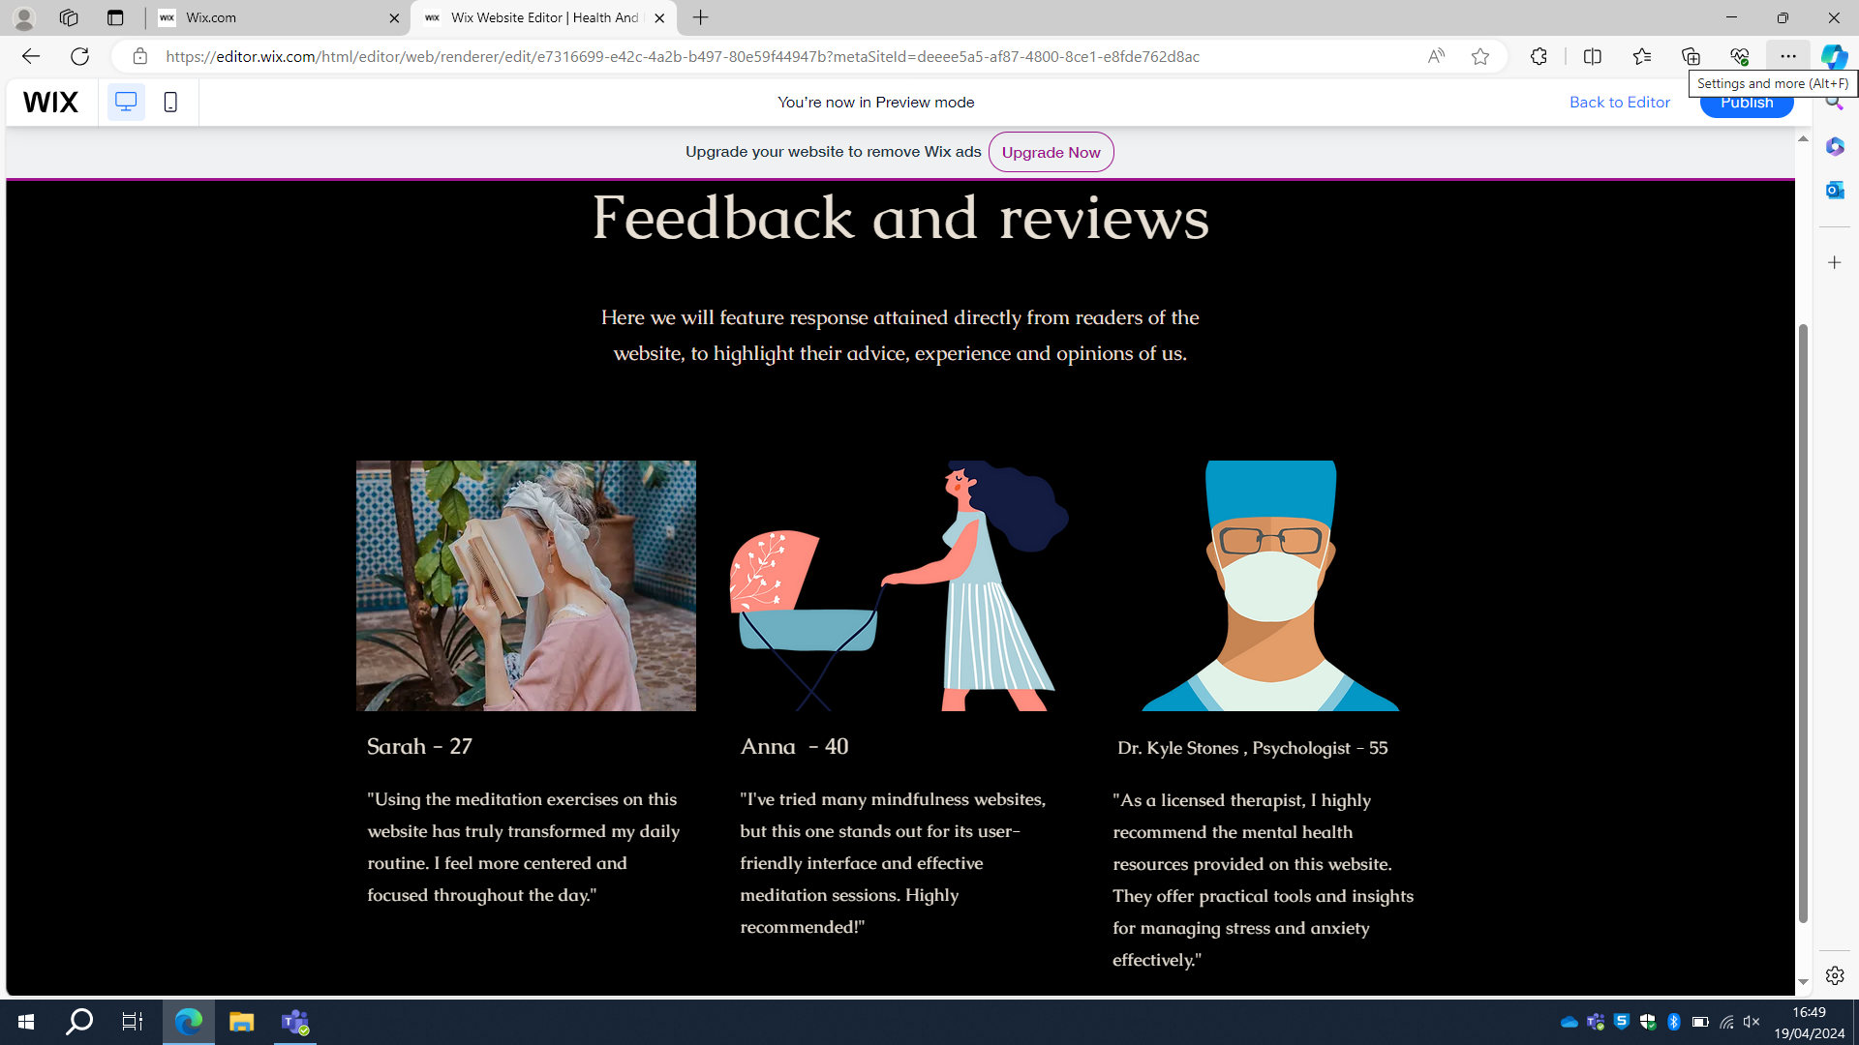
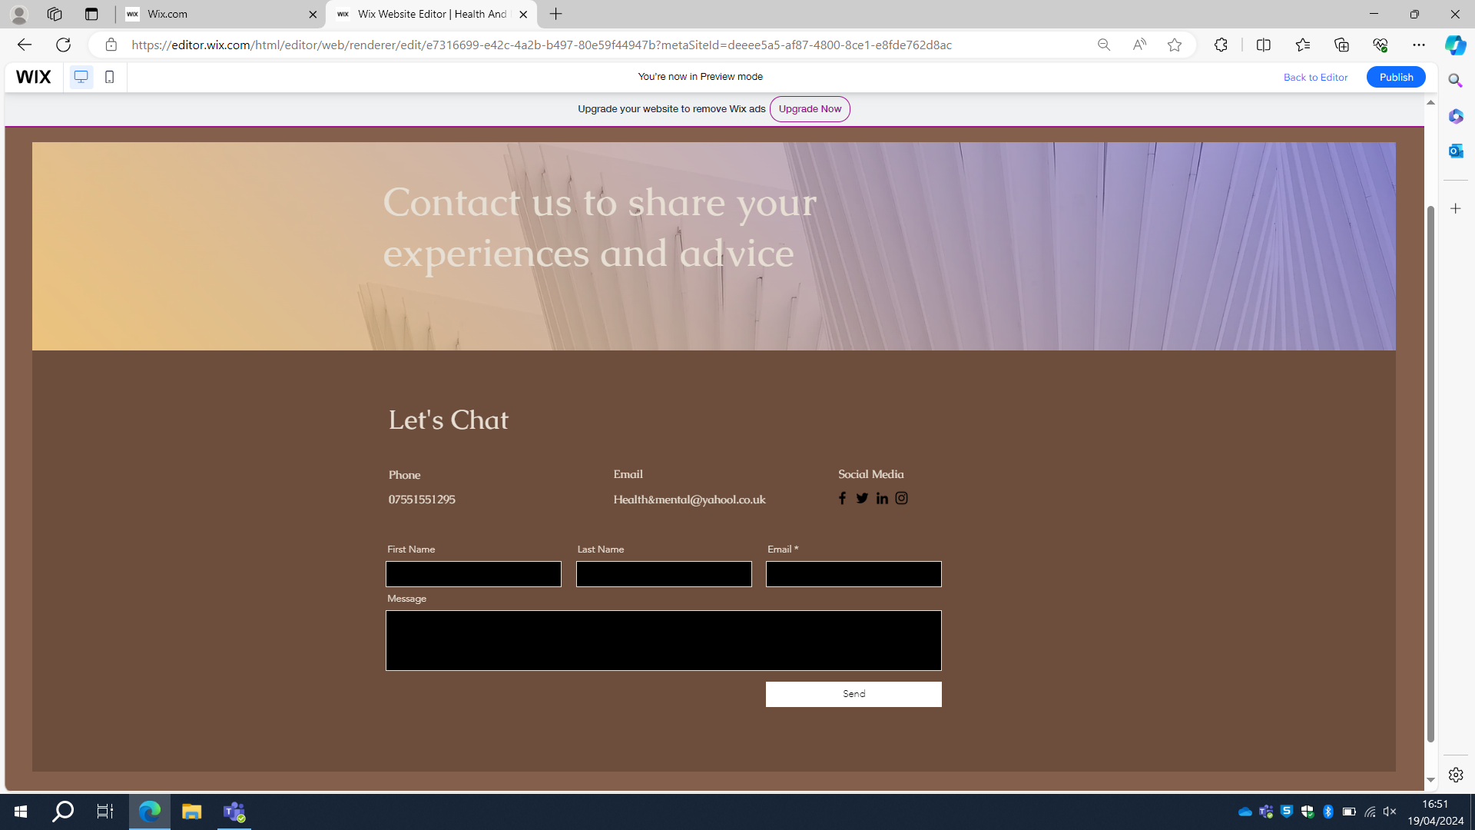
Final design
Keros

Slide 15
Website build and evaluation
Jensen
-Rough plan created, structure solidified in easy-to-understand form.
-First page placed as homage to original idea, which was to promote the positive effects of fitness on the mind and body.
-Format worked on to provide maximum info to user in a convenient way, increasing retention.
-Testing on a weekly basis where we combined all up-to-date properties.
-Testing time used to solve any outstanding bugs or missing content.
-Evaluation carried out by proof reading and viewing in desktop format on a regular basis.
-Obtained goals? Yes.

Slide 16
Website build and evaluation
Jensen
-We've come to learn that an organisation and structure is very important for efficient production of work and maintaining a schedule
-Having a leader to take account of the progress of others and reflect it in their urgency is a strong guide.
-Personal responsibility is ensuring that you adequately do your part, getting your work done on time, while your responsibility to the team is to ensure clean and consistent communication, helping and providing engagement where needed.
-Interpersonal skills are required when working in a group to ensure all members understand each other and can work together efficiently. Delays can be caused by poor communication.

Slide 17
What we learnt as a team
Divine
Pre-planned organization and structure is important as without it work would be difficult and take longer than needed.
Regular checkups to ensure all work is being completed on schedule.
Not completing your task as well as team members completing their responsibilities will hold back the entire team.
Our Interpersonal skills were put to the test. Teamwork, motivation, active listening responsibility etc.
Flexibility is essential for the project as we all had different schedules and had to adapt accordingly.

Slide 18
Team meetings
Mahin
- Weekly meetings for understanding team progress and task levels
- Opportunity for deeper understanding beyond text communication
- Collaboration between individuals with aligned tasks
- Utilization of team meeting to assign new tasks or expedite ongoing ones

Slide 19


Slide 20
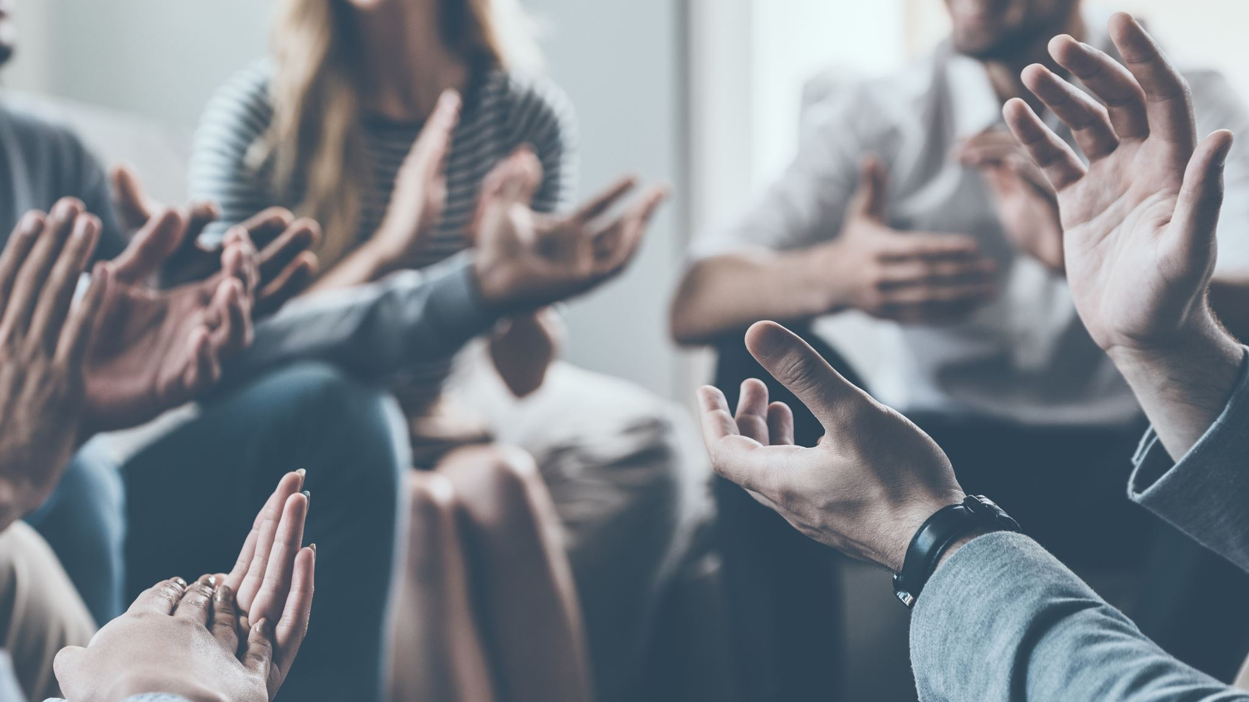
Thank you for listening.

